Slide 1
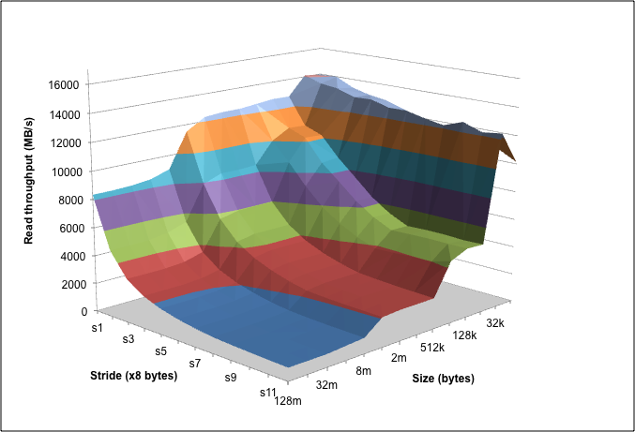
Introducing Computer Systems from a Programmer’s Perspective
Randal E. Bryant, David R. O’Hallaron
Computer Science, Electrical & Computer Engineering
Carnegie Mellon University

Slide 2
Outline
Introduction to Computer Systems
Course taught at CMU since Fall, 1998
Some ideas on labs, motivations, …
Computer Systems: A Programmer’s Perspective
Our textbook, now in its third edition
Ways to use the book in different courses

Slide 3
Background
1995-1997: REB/DROH teaching computer architecture course at CMU.
Good material, dedicated teachers, but students hate it
Don’t see how it will affect their lives as programmers

Slide 4
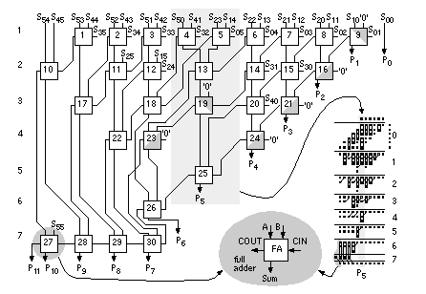
Computer Arithmetic Builder’s Perspective
32-bit
Multiplier
How to design high performance arithmetic circuits

Slide 5
Computer Arithmetic Programmer’s Perspective
void show_squares()
{
int x;
for (x = 5; x <= 5000000; x*=10)
printf("x = %d x^2 = %d\n", x, x*x);
}
x = 5 x² = 25
x = 50 x² = 2500
x = 500 x² = 250000
x = 5000 x² = 25000000
x = 50000 x² = -1794967296
x = 500000 x² = 891896832
x = 5000000 x² = -1004630016
Numbers are represented using a finite word size
Operations can overflow when values too large
But behavior still has clear, mathematical properties

Slide 6
Memory System Builder’s Perspective
Builder’s Perspective
Must make many difficult design decisions
Complex tradeoffs and interactions between components
Direct mapped or set indexed?
Synchronous
or
asynchronous?
Write through or write back?
Main
memory
Regs
L1 d-cache
L2
unified
cache
Disk
CPU
L1 i-cache
How many lines?
Virtual or physical indexing?

Slide 7
Memory System Programmer’s Perspective
void copyij(int src[2048][2048],
int dst[2048][2048])
{
int i,j;
for (i = 0; i < 2048; i++)
for (j = 0; j < 2048; j++)
dst[i][j] = src[i][j];
}
void copyji(int src[2048][2048],
int dst[2048][2048])
{
int i,j;
for (j = 0; j < 2048; j++)
for (i = 0; i < 2048; i++)
dst[i][j] = src[i][j];
}
4.3 ms
81.8 ms
(Measured on 2 GHz
Intel Core i7 Haswell)
19 times slower!
Hierarchical memory organization
Performance depends on access patterns
Including how step through multi-dimensional array

Slide 8
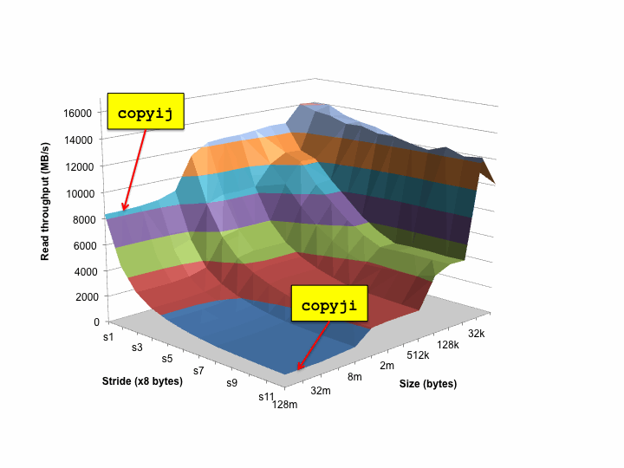
The Memory Mountain

Slide 9
Background (Cont.)
1997: OS instructors complain about lack of preparation
Students don’t know machine-level programming well enough
What does it mean to store the processor state on the run-time stack?
Our architecture course was not part of prerequisite stream

Slide 10
Birth of ICS
1997: REB/DROH pursue new idea:
Introduce them to computer systems from a programmer's perspective rather than a system designer's perspective.
Topic Filter: What parts of a computer system affect the correctness, performance, and utility of my C programs?
1998: Replace architecture course with new course:
15-213: Introduction to Computer Systems
Curriculum Changes
Sophomore level course
Eliminated digital design & architecture as required courses for CS majors

Slide 11
15-213: Intro to Computer Systems
Goals
Teach students to be sophisticated application programmers
Immediate value, even if never take another systems course
Prepare students for upper-level systems courses
Taught every semester to 400+ students
All CS undergrads (core course)
All ECE undergrads (core course)
Many masters students
To prepare them for upper-level systems courses
Variety of others from math, physics, statistics, …
Preparation
Optional: Introduction to CS in Python or Ruby
Imperative programming in C subset

Slide 12
ICS Feedback
Students
Faculty
Prerequisite for most upper level CS systems courses
Also required for ECE embedded systems, architecture, and network courses

Slide 13
Lecture Coverage
Data representations [3]
It’s all just bits.
int’s are not integers and float’s are not reals.
x86-64 machine language [5]
Analyzing and understanding compiler-generated machine code.
Program optimization [2]
Understanding compilers and modern processors.
Memory Hierarchy [3]
Caches matter!
Linking [1]
With DLL’s, linking is cool again!

Slide 14
Lecture Coverage (cont)
Exceptional Control Flow [2]
The system includes an operating system that you must interact with.
Virtual memory [4]
How it works, how to use it, and how to manage it.
Application level concurrency [3]
Processes and threads
Races, synchronization
I/O and network programming [4]
Programs often need to talk to other programs.
Total: 27 lectures, 14 week semester

Slide 15
Labs
Key teaching insight:
Cool Labs ⇒ Great Course
A set of 1 and 2 week labs define the course.
Guiding principles:
Be hands on, practical, and fun.
Be interactive, with continuous feedback from automatic graders
Find ways to challenge the best while providing worthwhile experience for the rest
Use healthy competition to maintain high energy.

Slide 16
Lab Exercises
Data Lab (2 weeks)
Manipulating bits.
Bomb Lab (2 weeks)
Defusing a binary bomb.
Attack Lab (1 week)
Buffer overflow and return-oriented programming exploits
Cache Lab (2 weeks)
Write basic cache simulator and then optimize application
Shell Lab (1 week)
Writing your own shell with job control.
Malloc Lab (2-3 weeks)
Writing your own malloc package.
Proxy Lab (2 weeks)
Writing your own concurrent Web proxy.

Slide 17
Data Lab
Goal: Solve some “bit puzzles” in C using a limited set of logical and arithmetic operators.
Examples: absval(x), greaterthan(x,y), log2(x)
Lessons:
Information is just bits in context.
C int’s are not the same as integers.
C float’s are not the same as reals.
Infrastructure
Configurable source-to-source C compiler that checks for compliance.
Instructor can automatically select from 45 puzzles.
Automatic testing using formal verification tools

Slide 18
Let’s Solve a Bit Puzzle!
/*
* abs - absolute value of x (except returns TMin for TMin)
* Example: abs(-1) = 1.
* Legal ops: ! ~ & ^ | + << >>
* Max ops: 10
* Rating: 4
*/
int abs(int x) {
int mask = x>>31;
return ____________________________;
}
11…1₂, = –1, x < 0
00…0₂, = 0, x ≥ 0
(x^mask)
+ 1+~mask
–x – 1, x < 0
x, x ≥ 0
+
1, x < 0
0, x ≥ 0
=
–x, x < 0
x, x ≥ 0

Slide 19
Verifying Solutions
int abs(int x) {
int mask = x>>31;
return (x ^ mask) + ~mask + 1;
}
int test_abs(int x) {
return (x < 0) ? -x : x;
}
Do these functions produce identical results?
How could you find out?

Slide 20
Bit-Level Program Model
int abs(int x) {
int mask = x>>31;
return (x ^ mask) + ~mask + 1;
}
x₀
abs
y₀
x₀
x₁
y₁
x₁
x₂
y₂
x₂
•
•
•
•
•
•
•
•
•
abs_{i}
•
•
•
•
•
•
•
•
•
y_{i}
x₃₁
y₃₁
x₃₁
View computer word as 32 separate bit values
Each output becomes Boolean function of inputs

Slide 21
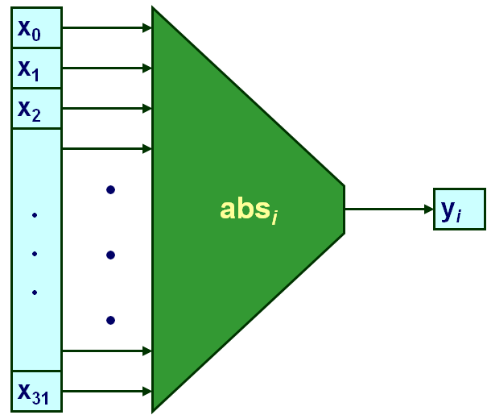
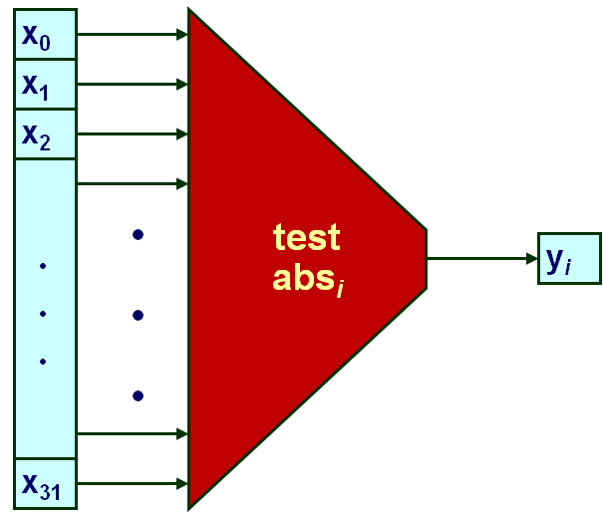
Bit-Level Program Verification
Determine whether functions equivalent for all outputs j
Exhaustive checking:
Single input:
Two input: 2⁶⁴ cases ➔ 8,800 years!
Other approaches
BDDs, SAT solvers
Easily handle these functions (< 1.0 seconds)
2³² cases X 50 cycles
2 X 10⁹ cycles / second
≈ 60 seconds

Slide 22
Verification Example
int iabs(int x) {
if (x == 1234567) x++;
int mask = x>>31;
return (x ^ mask) + ~mask + 1;
}
Almost Correct
Valid for all but one input value
Overlooked by our test suite

Slide 23
Counterexample Generation
int iabs(int x) {
if (x == 1234567) x++;
int mask = x>>31;
return (x ^ mask) + ~mask + 1;
}
Detected By Checking Code
Since covers all cases
Generate counterexample to demonstrate problem
int main()
{
int val1 = iabs(1234567);
int val2 = test_iabs(1234567);
printf("iabs(1234567) --> %d [0x%x]\n", val1, val1);
printf("test_iabs(1234567) --> %d [0x%x]\n", val2, val2);
if (val1 == val2) {
printf(".. False negative\n");
} else
printf(".. A genuine counterexample\n");
}

Slide 24
Bomb Lab
Idea due to Chris Colohan, TA during inaugural offering
Bomb: C program with six phases.
Each phase expects student to type a specific string.
Wrong string: bomb explodes by printing BOOM! (- ½ pt)
Correct string: phase defused (+10 pts)
In either case, bomb sends message to grading server
Server posts current scores anonymously and in real time on Web page
Goal: Defuse the bomb by defusing all six phases.
For fun, we include an unadvertised seventh secret phase
The challenge:
Each student get only binary executable of a unique bomb
To defuse their bomb, students must disassemble and reverse engineer this binary

Slide 25
Properties of Bomb Phases
Phases test understanding of different C constructs and how they are compiled to machine code
Phase 1: string comparison
Phase 2: loop
Phase 3: switch statement/jump table
Phase 4: recursive call
Phase 5: pointers
Phase 6: linked list/pointers/structs
Secret phase: binary search (biggest challenge is figuring out how to reach phase)
Phases start out easy and get progressively harder

Slide 26
Let’s defuse a bomb phase!
0000000000400a6c <phase_2>:
... # function prologue not shown
400a72: mov %rsp,%rsi
400a75: callq 4010ba <read_six_numbers>
400a7a: cmpl $0x1,(%rsp)
400a7e: je 400a85 <phase_2+0x19>
400a80: callq 400f6d <explode_bomb>
400a85: lea 0x4(%rsp),%rbx
400a8a: lea 0x18(%rsp),%rbp
400a8f: mov -0x4(%rbx),%eax
400a92: add %eax,%eax
400a94: cmp %eax,(%rbx)
400a96: je 400a9d <phase_2+0x31>
400a98: callq 400f6d <explode_bomb>
400a9d: add $0x4,%rbx
400aa1: cmp %rbp,%rbx
400aa4: jne 400a8f <phase_2+0x23>
... # function epilogue not shown
400aac: c3 retq
# rd 6 ints into buffer
# p = &buf[1]
# pend = &buf[6]
# LOOP: v = buf[0]
# v = 2*v
# if v == *p
# then goto OK:
# else explode!
# OK: p++
# if p != pend
# then goto LOOP:
# YIPPEE!

Slide 27
Source Code for Bomb Phase
/*
* phase2b.c - To defeat this stage the user must enter the geometric
* sequence starting at 1, with a factor of 2 between each number
*/
void phase_2(char *input)
{
int i;
int numbers[6];
read_six_numbers(input, numbers);
if (numbers[0] != 1)
explode_bomb();
for(i = 1; i < 6; i++) {
if (numbers[i] != numbers[i-1] * 2)
explode_bomb();
}
}

Slide 28
The Beauty of the Bomb
For the Student
Get a deep understanding of machine code in the context of a fun game
Learn about machine code in the context they will encounter in their professional lives
Working with compiler-generated code
Learn concepts and tools of debugging
Forward vs backward debugging
Students must learn to use a debugger to defuse a bomb
For the Instructor
Self-grading
Scales to different ability levels
Easy to generate variants and to port to other machines

Slide 29
Attack Lab
int getbuf()
{
char buf[4];
/* Read line of text and store in buf */
gets(buf);
return 1;
}
Task
Each student assigned “cookie”
Randomly generated 8-digit hex string
Generate string that will cause getbuf to return cookie
Instead of 1

Slide 30
Buffer Code
Stack when gets called
Stack Frame
for test
void test(){
int v = getbuf();
...
}
Return
address
Return Address
(8 bytes)
void getbuf() {
char buf[4];
gets(buf);
return 1;
}
20 bytes unused
Increasing
addresses
[3]
[2]
[1]
[0]
buf
%rsp
Calling function gets(p) reads characters up to ‘\n’
Stores string + terminating null as bytes starting at p
Assumes enough bytes allocated to hold entire string

Slide 31
Buffer Code: Good case
Input string
“01234567890123456789012”
void test(){
int v = getbuf();
...
}
Stack Frame
for test
Return
address
00
00
00
00
Return Address
(8 bytes)
void getbuf() {
char buf[4];
gets(buf);
return 1;
}
00
40
06
f6
00
32
31
30
20 bytes unused
Increasing
addresses
39
38
37
36
35
34
33
32
31
30
39
38
37
36
35
34
33
32
31
30
buf
%rsp
Fits within allocated storage
String is 23 characters long + 1 byte terminator

Slide 32
Buffer Code: Bad case
Input string
“0123456789012345678901234”
void test(){
int v = getbuf();
...
}
Stack Frame
for test
Return
address
00
00
00
00
Return Address
(8 bytes)
void getbuf() {
char buf[4];
gets(buf);
return 1;
}
00
40
00
34
33
32
31
30
Increasing
addresses
20 bytes unused
39
38
37
36
35
34
33
32
31
30
39
38
37
36
35
34
33
32
31
30
buf
%rsp
Overflows allocated storage
Corrupts saved frame pointer and return address
Jumps to address 0x400034 when getbuf attempts to return
Program executes some instruction and then segfaults

Slide 33
Malicious Use of Buffer Overflow
Stack after call to gets()
void test(){
int v = getbuf();
...
}
test
stack frame
Return
address
B
void getbuf() {
char buf[4];
gets(buf);
return 1;
}
pad
data written
by gets()
exploit
code
getbuf
stack frame
B
Input string contains byte representation of executable code
Overwrite return address with address of buffer
When getbuf() executes return instruction, will jump to exploit code

Slide 34
Exploit String Example
Stack after call to gets()
test
stack frame
void getbuf() {
char buf[4];
gets(buf);
return 1;
}
B
pad
data written
by gets()
Sets 0x59b997fa as function argument
Invokes function touch2
getbuf
stack frame
exploit
code
B
/* Byte code for shell code
movq $0x59b997fa,%rdi; ret */
48 c7 c7 fa 97 b9 59 c3
/* Pad with 16 bytes */
00 00 00 00 00 00 00 00
00 00 00 00 00 00 00 00
/* Address of shellcode */
78 dc 61 55 00 00 00 00
/* Address of touch2 */
0c 18 40 00 00 00 00 00

Slide 35
Why Do We Teach This Stuff?
Important Systems Concepts
Stack discipline and stack organization
Instructions are byte sequences
Making use of tools
Debuggers, assemblers, disassemblers
Computer Security
What makes code vulnerable to buffer overflows
Common vulnerability in systems
Impact
CMU student teams consistently win international Capture the Flag Competitions

Slide 36
Cache Lab
Goal: Understanding Cache Operations
How memory locations map to cache blocks
Performance implications for application programs
Activities
Write cache simulator
Provides full understanding of mapping from memory address to cache location
Minimize cache misses for simple application
Matrix transpose

Slide 37
Shell Lab
Goal: Write a Unix shell with job control
(e.g., ctrl-z, ctrl-c, jobs, fg, bg, kill)
Lessons:
First introduction to systems-level programming and concurrency
Learn about processes, process control, signals, and catching signals with handlers
Demystifies command line interface
Infrastructure
Students use a scripted autograder to incrementally test functionality in their shells

Slide 38
Malloc Lab
Goal: Build your own dynamic storage allocator
void *malloc(size_t size)
void *realloc(void *ptr, size_t size)
void free(void *ptr)
Lessons
Sense of programming underlying system
Large design space with classic time-space tradeoffs
Develop understanding of scary “action at a distance” property of memory-related errors
Learn general ideas of resource management
Infrastructure
Trace driven test harness evaluates implementation for combination of throughput and memory utilization
Evaluation server and real time posting of scores

Slide 39
Proxy Lab
Goal: write concurrent Web proxy.
Lessons: Ties together many ideas from earlier
Data representations, byte ordering, memory management, concurrency, processes, threads, synchronization, signals, I/O, network programming, application-level protocols (HTTP)
Infrastructure:
Plugs directly between existing browsers and Web servers
Grading is done via autograders and one-on-one demos
Very exciting for students, great way to end the course
Web
Browser
Web
Proxy
Web
Server

Slide 40
ICS Summary
Principle
Introduce students to computer systems from the programmer's perspective rather than the system builder's perspective
Themes
What parts of the system affect the correctness, efficiency, and utility of my C programs?
Makes systems fun and relevant for students
Prepare students for builder-oriented courses
Architecture, compilers, operating systems, networks, distributed systems, databases, …
Since our course provides complementary view of systems, does not just seem like a watered-down version of a more advanced course
Gives them better appreciation for what to build

Slide 41
CMU Courses that Build on ICS
CS
Robotics
ECE
Parallel
Prog.
Compilers
Dist.
Systems
Cog.
Robotics
Embedded
Control
Secure
Coding
Networks
Storage
Systems
Comp.
Photo.
Real-Time
Systems
Software
Engin.
Operating
Systems
Databases
Computer
Graphics
Embedded
Systems
Computer
Arch.
ICS

Slide 42
Fostering “Friendly Competition”
Desire
Challenge the best without frustrating everyone else
Method
Web-based submission of solutions
Server checks for correctness and computes performance score
How many stages passed, program throughput, …
Keep updated results on web page
Students choose own nom de guerre
Relationship to Grading
Students get full credit once they reach set threshold
Push beyond this just for own glory/excitement

Slide 43
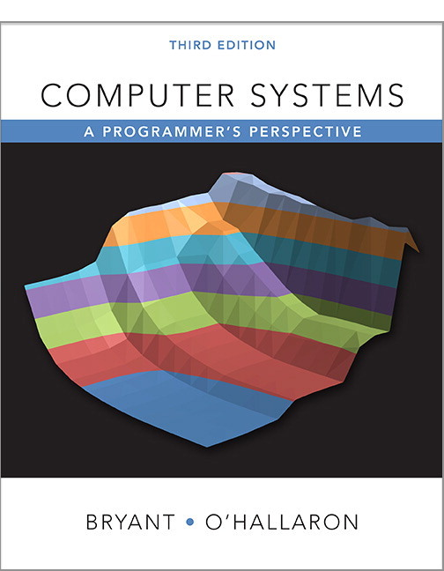
Shameless Promotion
http://csapp.cs.cmu.edu
Third edition published 2015
In use at 289 institutions worldwide

Slide 44
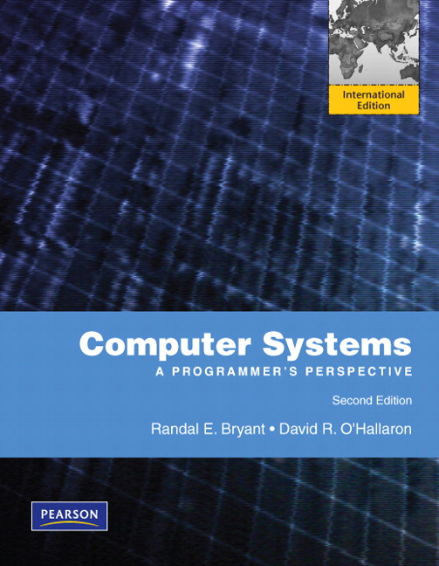
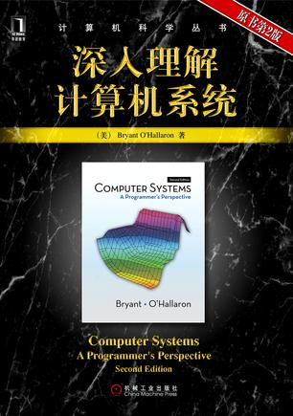
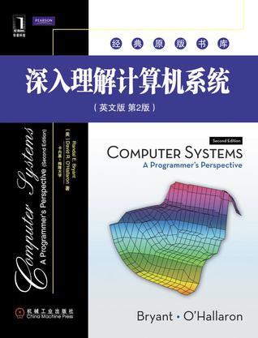
International Editions (No 3rd edition yet)

Slide 45
Overall Sales
All Editions
As of 6/30/2015
175,835 total

Slide 46
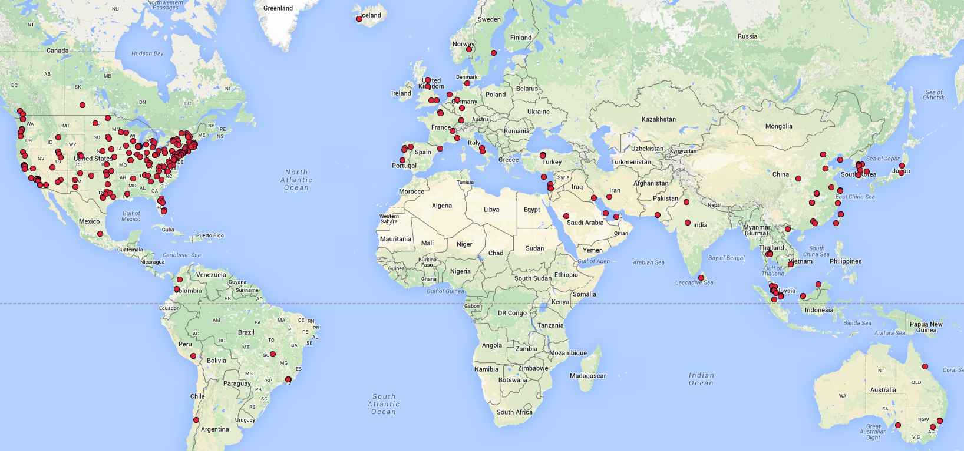
Worldwide Adoptions
289 total

Slide 47
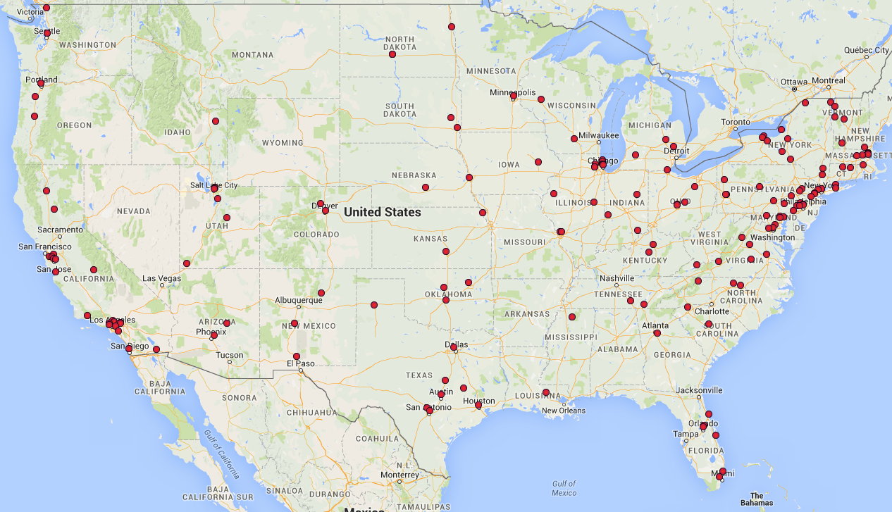
US Adoptions
176 total

Slide 48
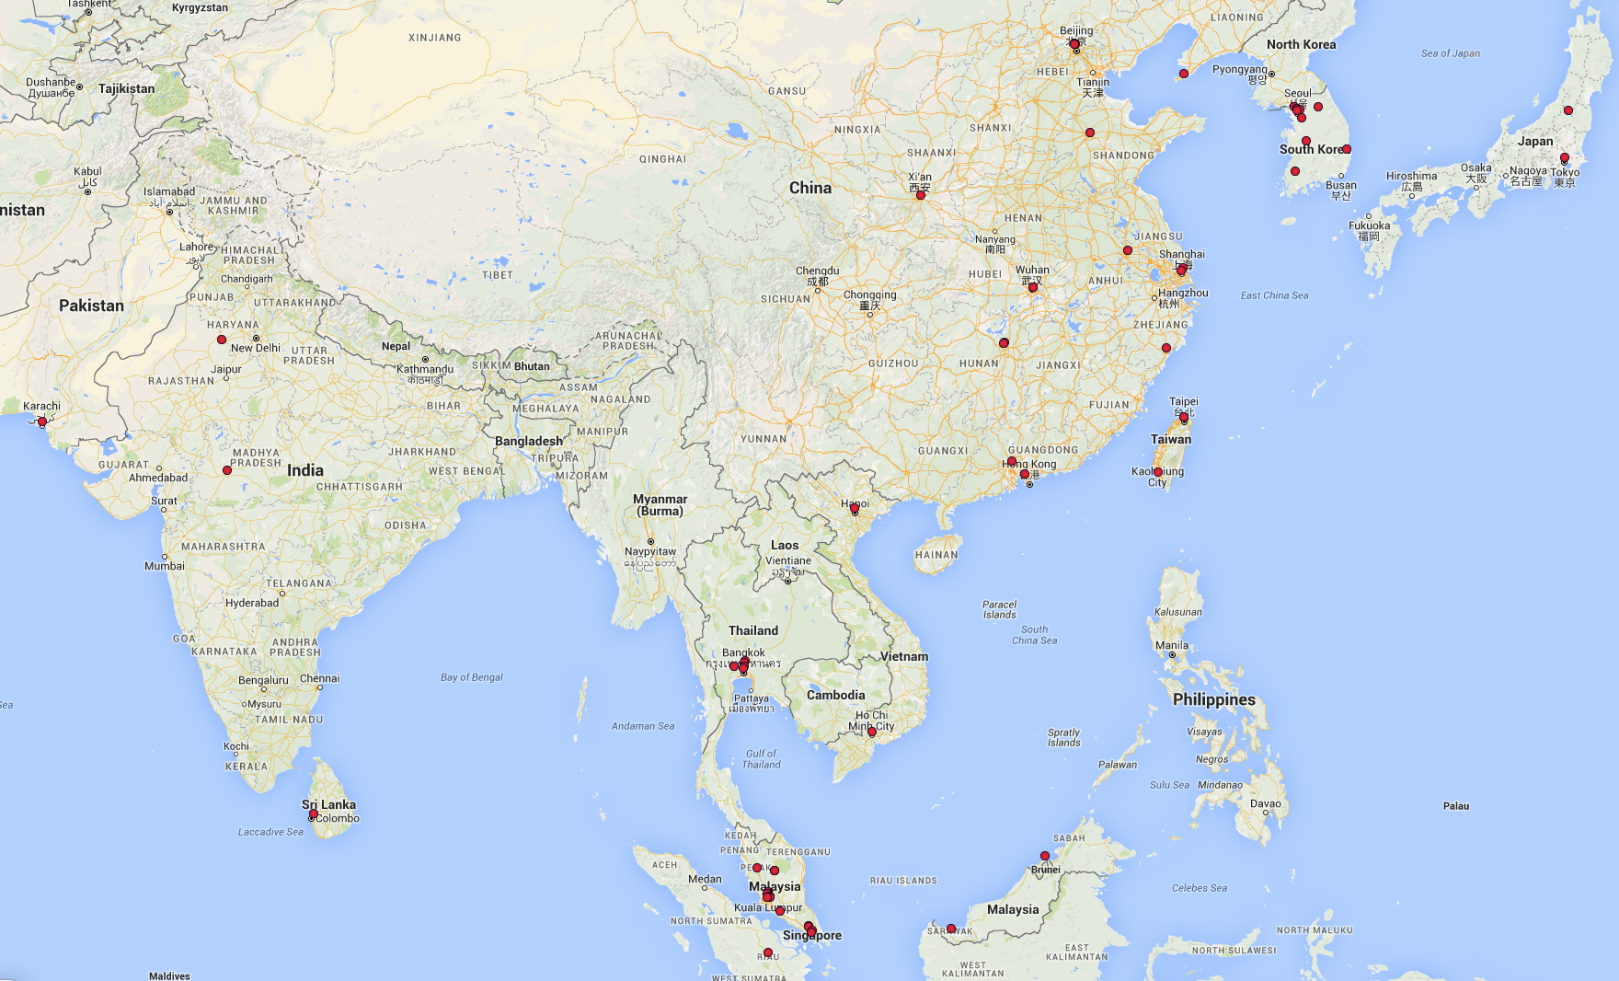
Asian Adoptions

Slide 49
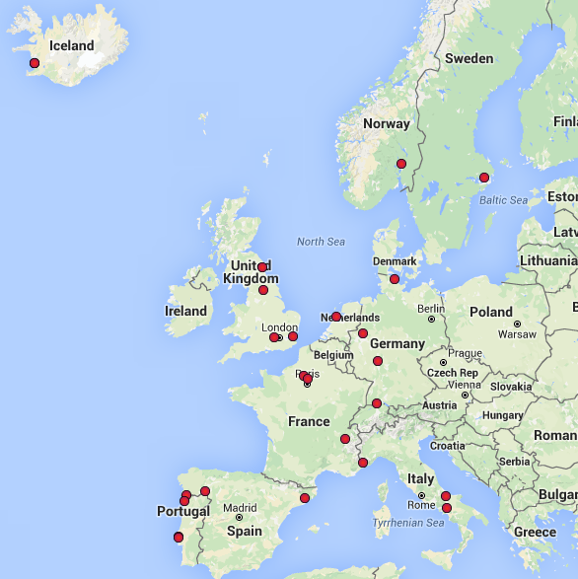
European Adoptions

Slide 50
CS:APP3e
Vital stats:
12 chapters
267 practice problems (solutions in book)
226 homework problems (solutions in instructor’s manual)
544 figures, 342 line drawings
Many C & machine code examples
Turn-key course provided with book:
Electronic versions of all code examples.
Powerpoint and PDF versions of each line drawing
Password-protected Instructors Page
Instructor’s Manual
Lab Infrastructure
Powerpoint lecture notes
Exam problems.

Slide 51
Coverage
Material Used by ICS at CMU
Pulls together material previously covered by multiple textbooks, system programming references, and man pages
Greater Depth on Some Topics
Dynamic linking
I/O multiplexing
Additional Topic
Computer Architecture
Added to cover all topics in “Computer Organization” course

Slide 52
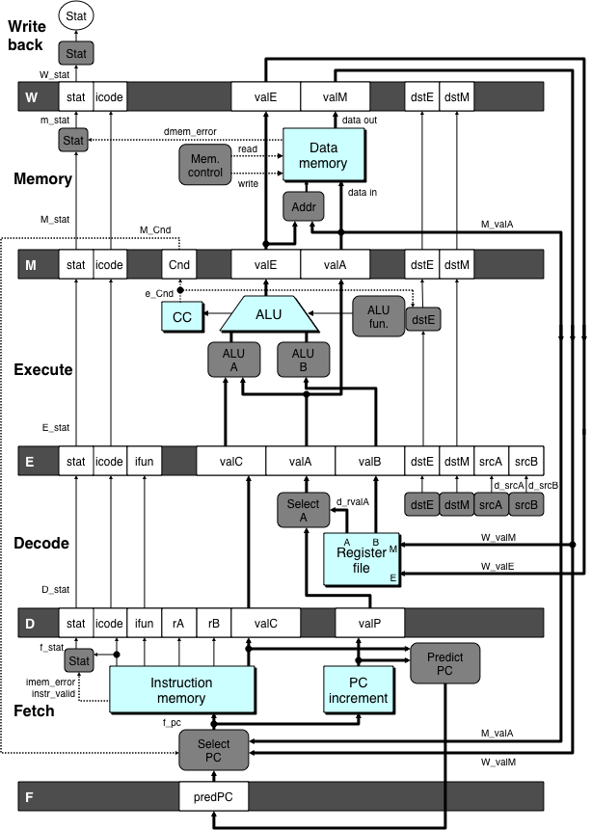
Architecture
Material
Y86-64 instruction set
Simplified/reduced x86-64
Implementations
Sequential
5-stage pipeline
Presentation
Simple hardware description language to describe control logic
Automatic translation to simulator and to Verilog
Labs
Modify / extend processor design
New instructions
Change branch prediction policy
Optimize application + processor

Slide 53
Web Asides
Supplementary material via web
Topics either more advanced or more arcane
Examples
Boolean algebra & Boolean rings
IA32 programming
Combining assembly & C code
Processor design in Verilog
Using SIMD instructions
Memory blocking

Slide 54
Courses Based on CS:APP
Computer Organization
ORG Topics in conventional computer organization course, but with a different flavor
ORG+ Extends computer organization to provide more emphasis on helping students become better application programmers
Introduction to Computer Systems
ICS Create enlightened programmers who understand enough about processor/OS/compilers to be effective
ICS+ What we teach at CMU. More coverage of systems software
Systems Programming
SP Prepare students to become competent system programmers

Slide 55
Courses Based on CS:APP
Chapter | Topic | Course
 |  | ORG | ORG+ | ICS | ICS+ | SP
1 | Introduction |  |  |  |  | 
2 | Data representations |  |  |  |  | 
3 | Machine language |  |  |  |  | 
4 | Processor architecture |  | 
5 | Code optimization |  |  |  | 
6 | Memory hierarchy |  |  |  |  | 
7 | Linking |  |  |  |  | 
8 | Exceptional control flow |  |  |  |  | 
9 | Virtual memory |  |  |  |  | 
10 | System-level I/O |  |  |  |  | 
11 | Concurrent programming |  |  |  |  | 
12 | Network programming |  |  |  |  | 
 Partial Coverage  Complete Coverage

Slide 56
Conclusions
ICS Has Proved Its Success
Thousands of students at CMU over 13 years
Positive feedback from alumni
Positive feedback from systems course instructors
CS:APP is International Success
Supports variety of course styles
Many purchases for self study

